Slide 1

Patient Data Analysis for Improved Healthcare Outcomes: Part II
Presentation by:
Gabriel Penzo

Slide 2
Table of Contents
Introduction
Objectives
Data
Methodology
Analysis
References

Slide 3

Introduction
Healthcare professionals must make informed decisions about patients’ treatments using databases that allow the analysis of many health metrics that can show critical insights that may benefit the patient’s recovery and treatment plan. This presentation aims to demonstrate how this data can be analyzed to improve healthcare outcomes by using different statistical tests. With the use of Python’s Pandas, Scipy, and Matplot, these functionalities will find any correlations, differences among groups, and patient distributions that will help investigate the relationship between certain lifestyle factors.

Slide 4

Objectives
Analyze the database and generate a descriptive statistics report.
The use of statistical analyses to identify outliers and patients that need urgent care based on their health metrics.
Evaluate lifestyle factors and their impact on chronic conditions by making use of statistical tests to identify correlations.
Perform t-tests and ANOVA tests to identify significant differences between groups.

Slide 5
Data
hospital_database.csv
Patient_info1.csv
Variable Name | Data Type
Patient ID | Integer
Systolic BP | Integer
Diastolic BP | Integer
Cholesterol | Integer
Diabetic Status | String
Alcohol Consumption | String
90
observations
For this presentation, dummy data was created and will be used to demonstrate the different functionalities using health metrics. Four tables were created.
Patient_info2.csv
66
observations
patient_info1.csv and patient_info2.csv
Variable Name | Data Type
Patient ID | Integer
Name | String
Age | Integer
Gender | String
Ethnicity | String
medical_info.csv
hospital_database.csv
Variable Name | Data Type
Patient ID | Integer
Allergies | String
Surgeries | String
Medical Conditions | String
Exercise | String
Smoking Status | String
150
observations
medical_info.csv
150
observations

Slide 6

Methodology
Creating four tables using dummy data.
Loading the four tables using the read_csv function, cleaning the data, and merging all the tables.
Created different functionalities:
Merging of all four tables.
Allow the user to append new patients to the existing database.
Descriptive statistics report.
Outliers detector.
Pearson Correlation between groups.
Added a new column for cardiovascular risk categories.
T-tests and ANOVA tests between groups.
Patient distribution among different groups.
Overview Report of all functionalities.

Slide 7
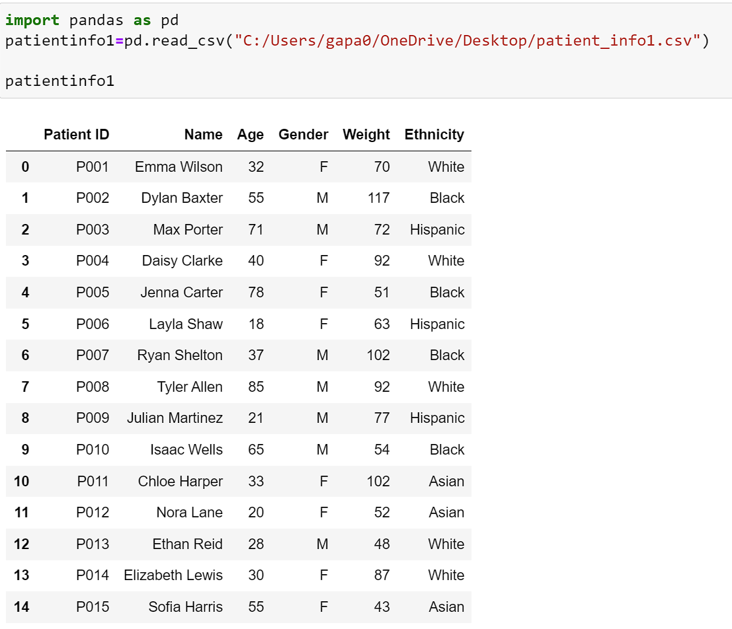
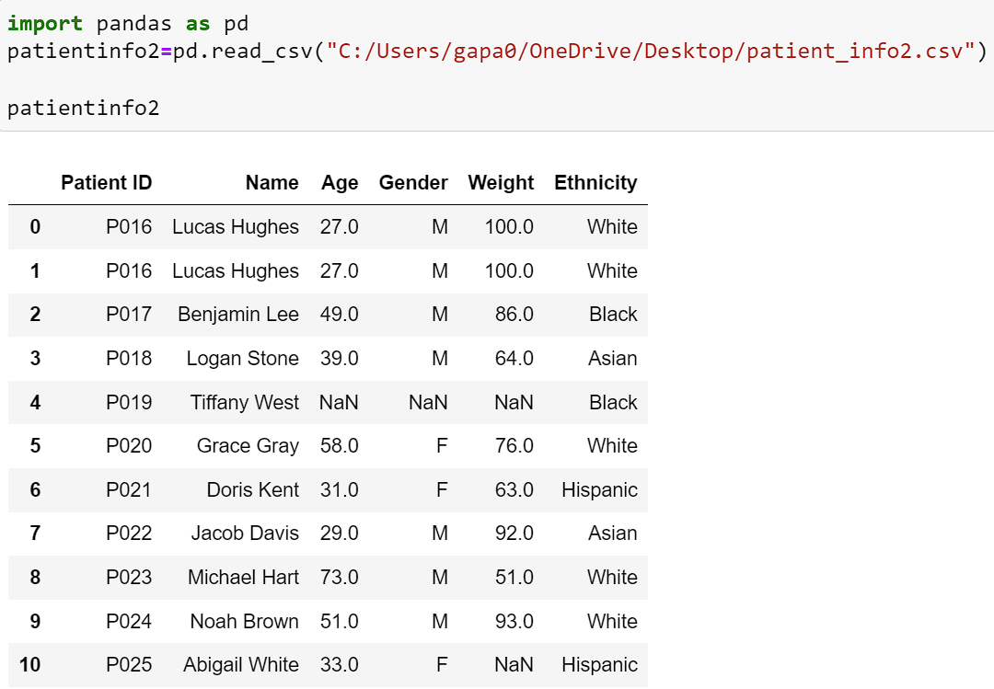
Data Loading
The four tables were loaded using the read_csv function.

Slide 8
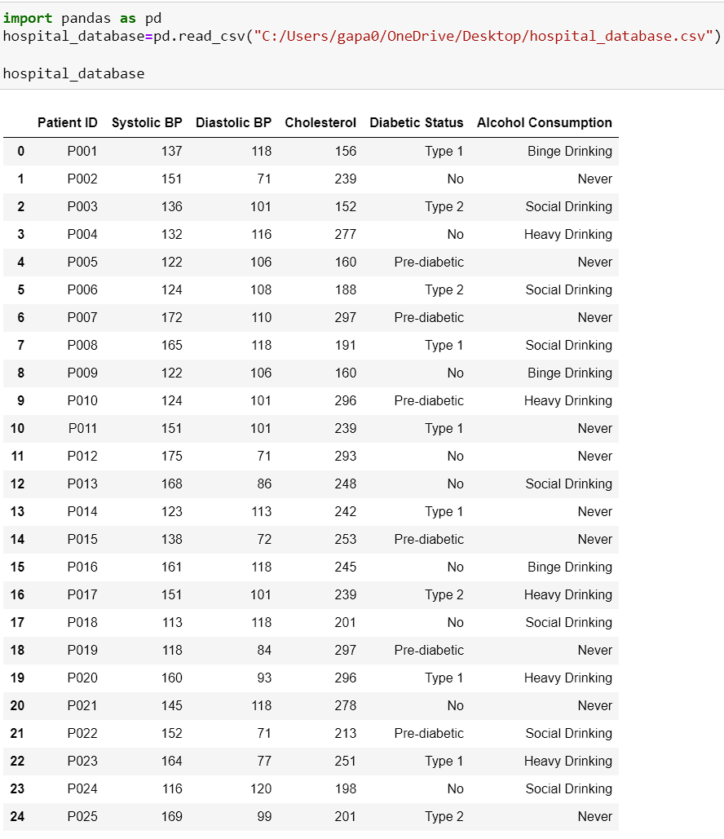
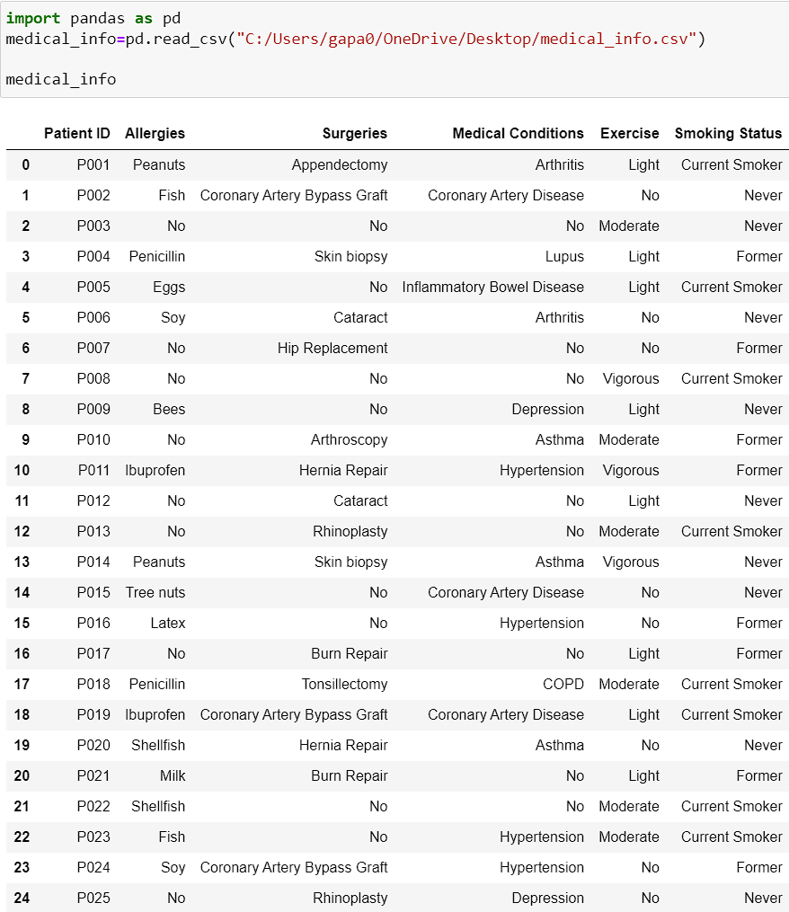

Slide 9
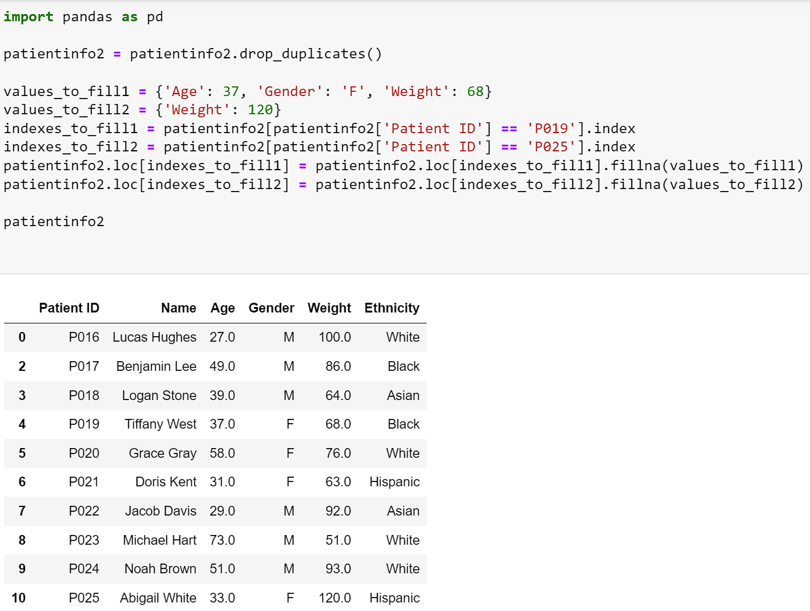
Cleaning
After loading the tables, patient_info2 dataset was cleaned by removing a duplicate for ‘P016’ by using the drop_duplicates() function and filling some missing values for ‘P019’ and ‘P025’ by using the fillna() function and index function.

Slide 10
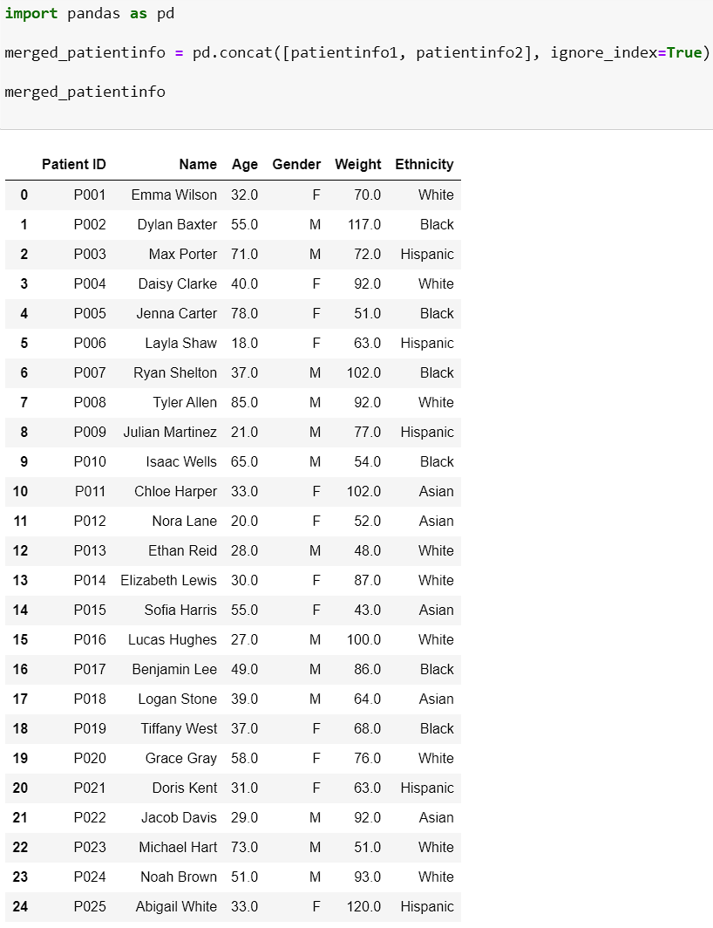
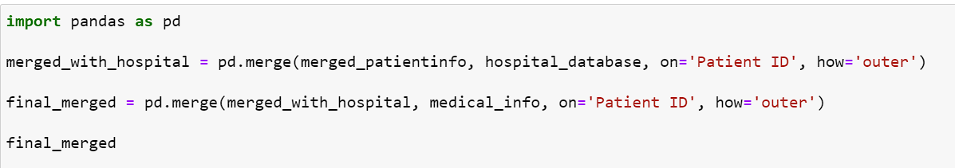
Merging
Patientinfo1 and patientinfo2 were vertically joined using the pd.concat function. Then the merged_patientinfo table was horizontally with the other two tables in the code shown below using the pd.merge function.

Slide 11
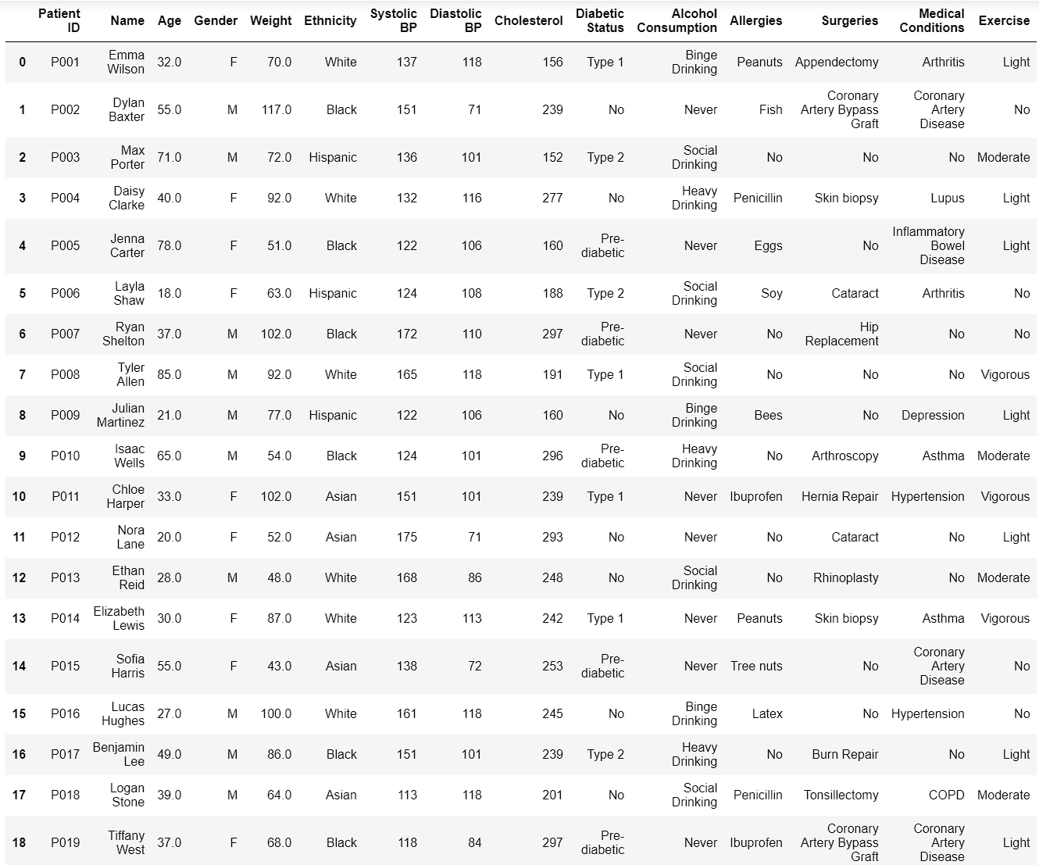
Output of full merge. This screenshot only shows the first 19 patients, and it is missing the ‘Smoking Status’ column (not shown unless the user scrolls right).

Slide 12
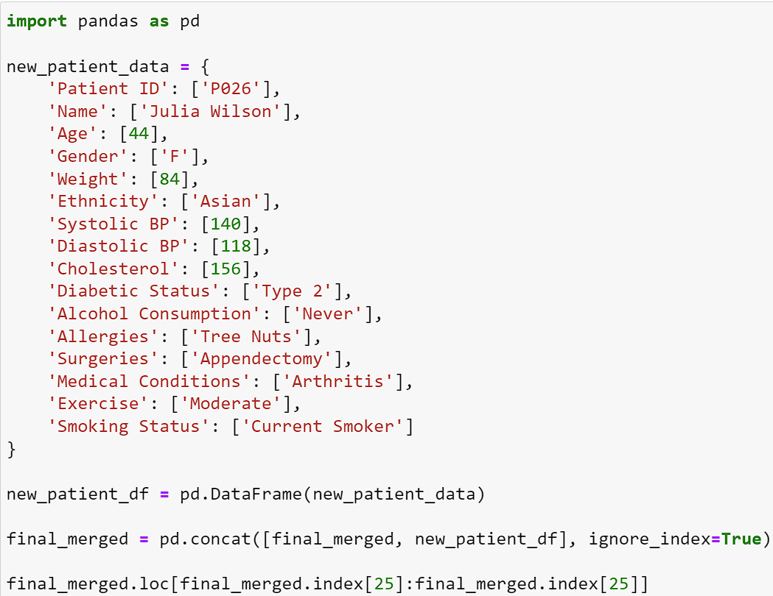
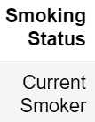
Append
This code allows the user to append new patients to the DataFrame. In the output, only the new patient is shown.

Slide 13
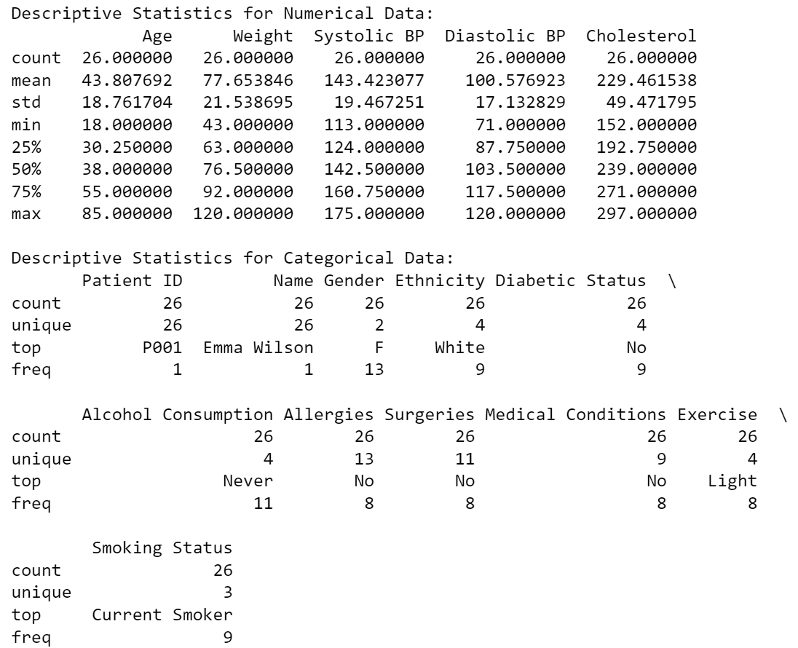
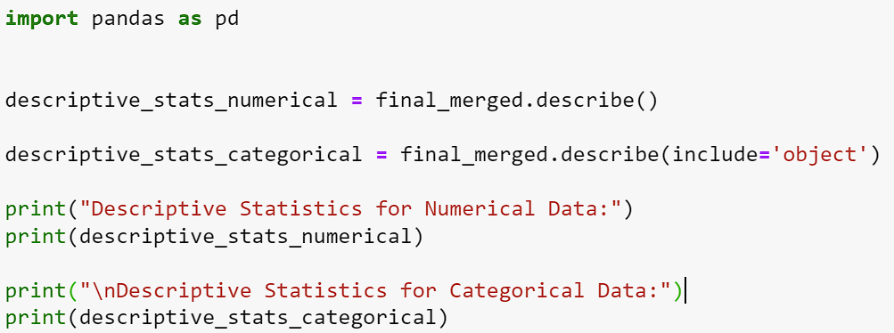
Analysis: Descriptive Statistics
Using the describe function, a descriptive statistics report was generated for the database that can be used for identifying errors and outliers, data quality assessments, and helping healthcare professionals make informed medical decisions, and it may also serve for further statistical analysis.

Slide 14
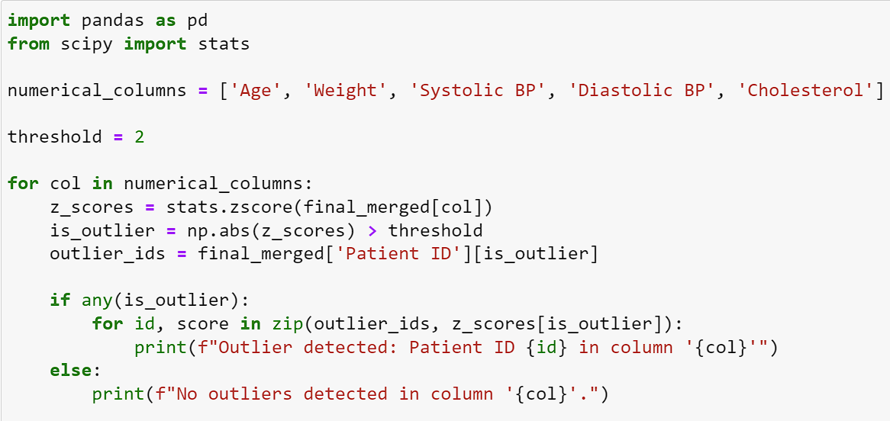
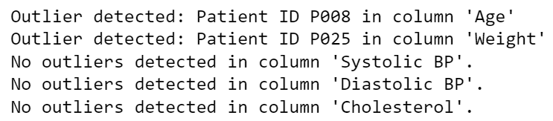
Outliers Detector
This code uses Scipy to detect any outliers in the dataframe. By knowing what patients are showing any atypical symptoms, healthcare professionals can make sure to change management strategies and target patients who need immediate attention.

Slide 15
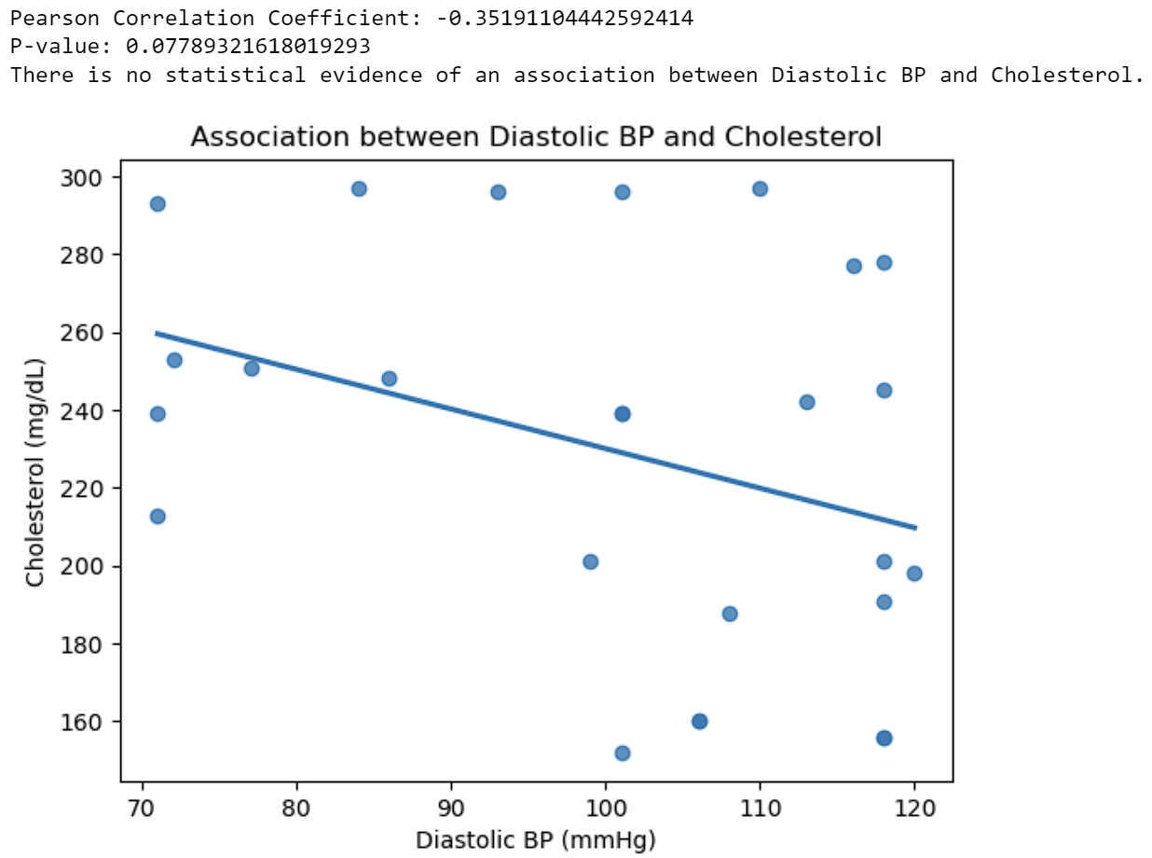
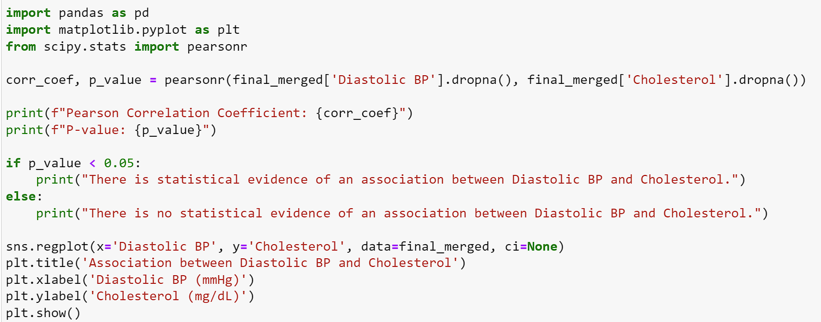
Correlation Between Diastolic BP and Cholesterol
To find any correlation between Diastolic BP and Cholesterol levels, a Pearson Correlation test was performed using Scipy, and the results were plotted in a scatterplot with a regression line using Matplot. This code can be edited to find correlations with other factors like Systolic BP (Zhang, 2019).

Slide 16
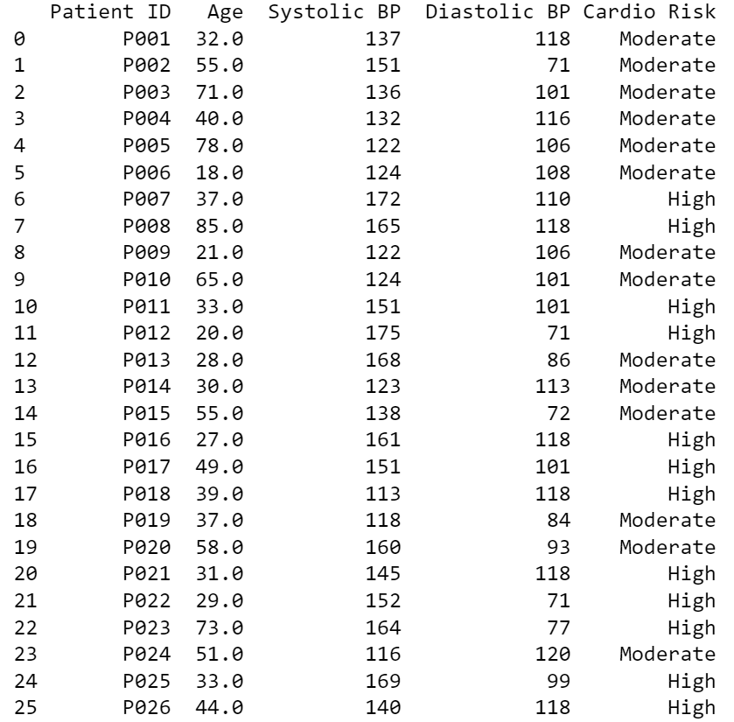
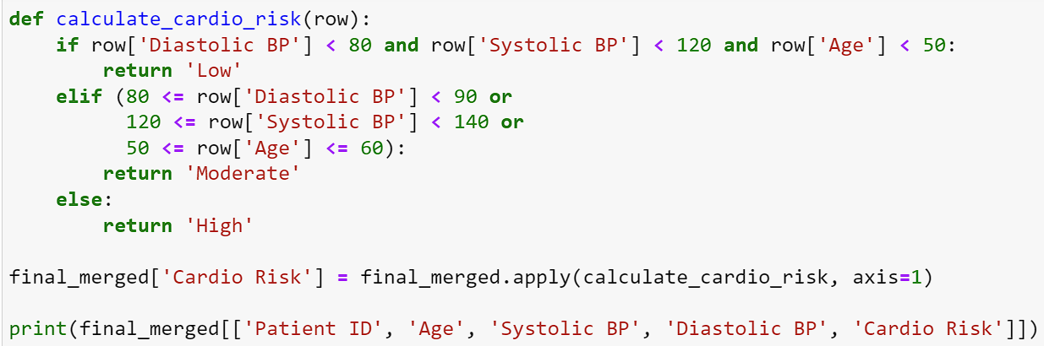
Cardiovascular Risk Categorization
In this output, only the necessary columns were printed.
This code adds a new column to the dataframe “Cardio Risk” and uses the patient’s Age, Diastolic BP, and Systolic BP to assess any risk that the patient might suffer from a heart condition in the future (Flint, 2019).

Slide 17
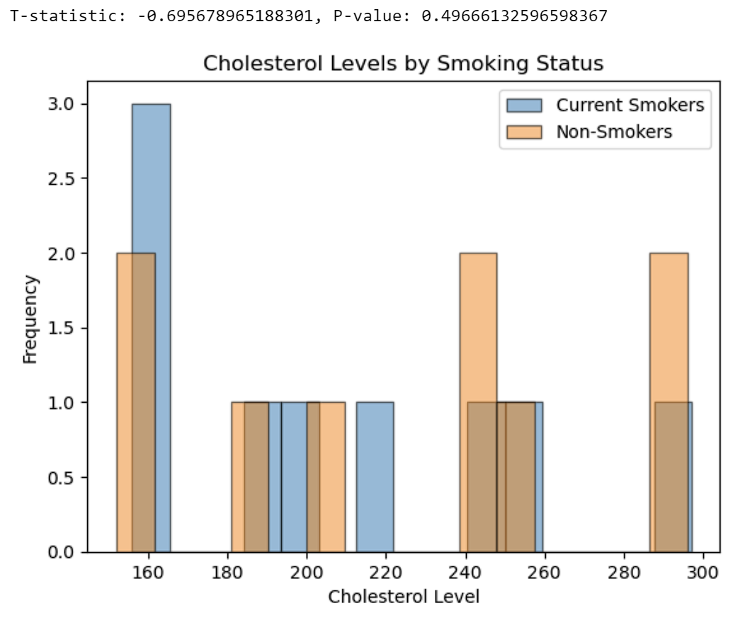
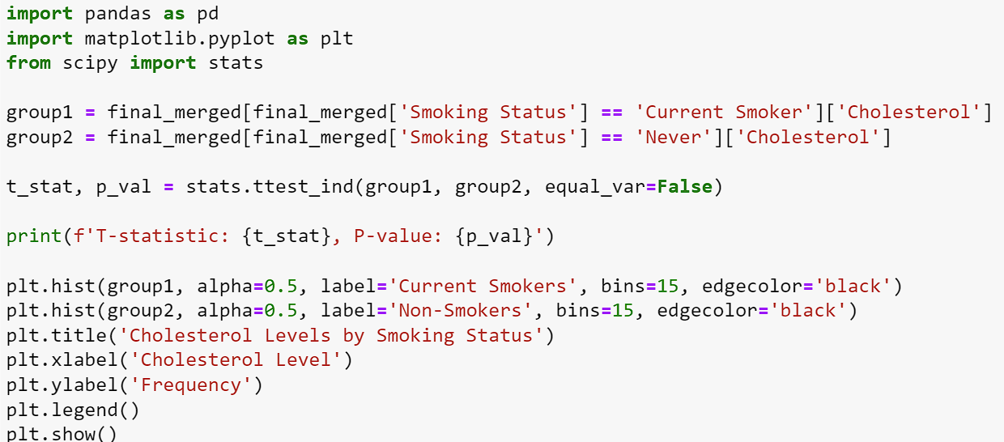
T-Test
A t-test was performed to determine any significant difference between cholesterol levels and smoking status. The results suggest that there isn’t any significant difference between the groups since the p-value is higher than 0.05.

Slide 18
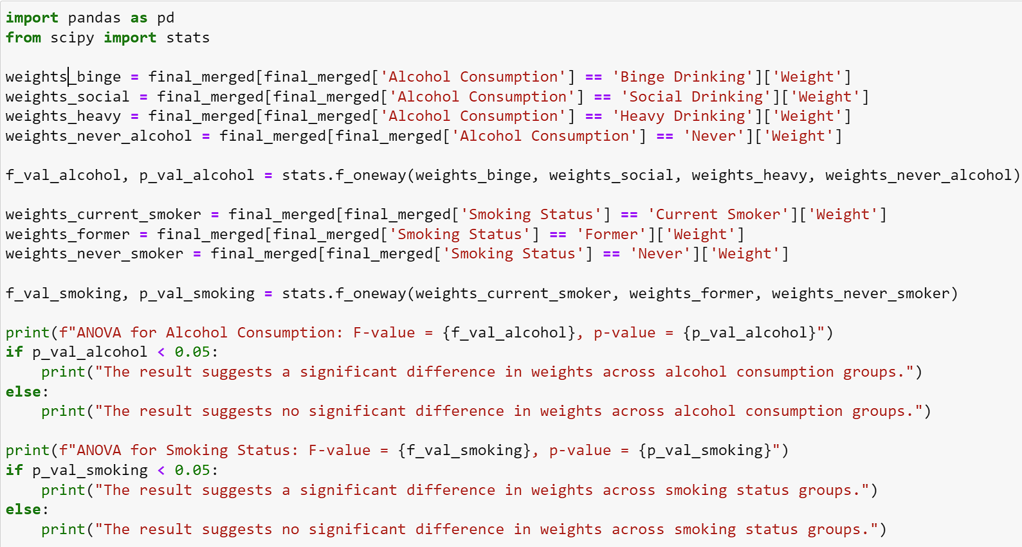
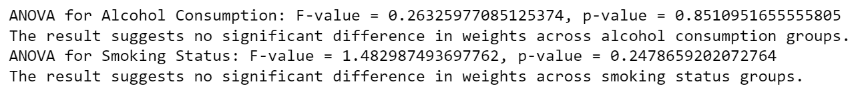
ANOVA
An ANOVA Test was performed to find any significant difference between alcohol consumption, smoking status, and weight. The results suggest there is not any significant difference in weights across smoking status and alcohol consumption groups.

Slide 19
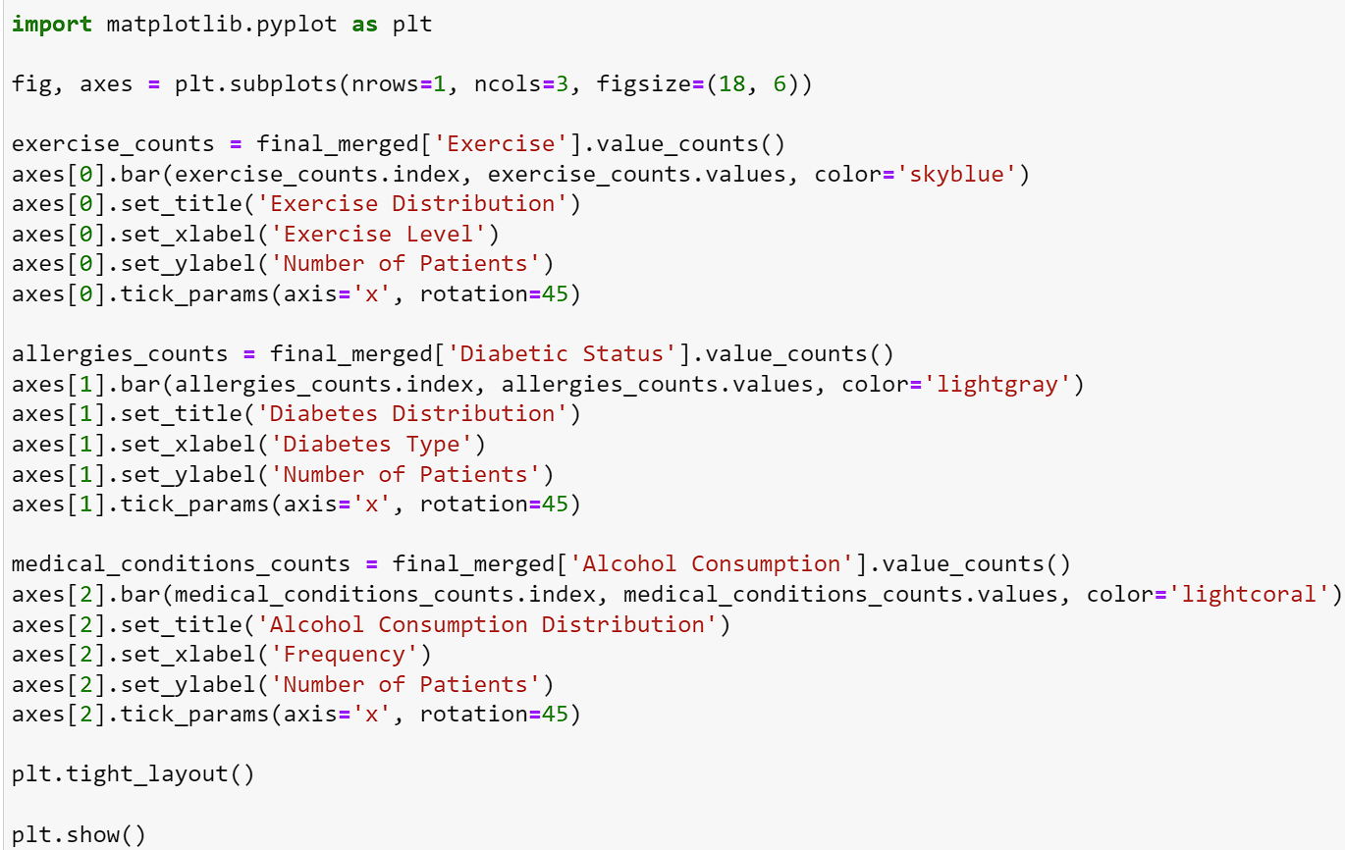
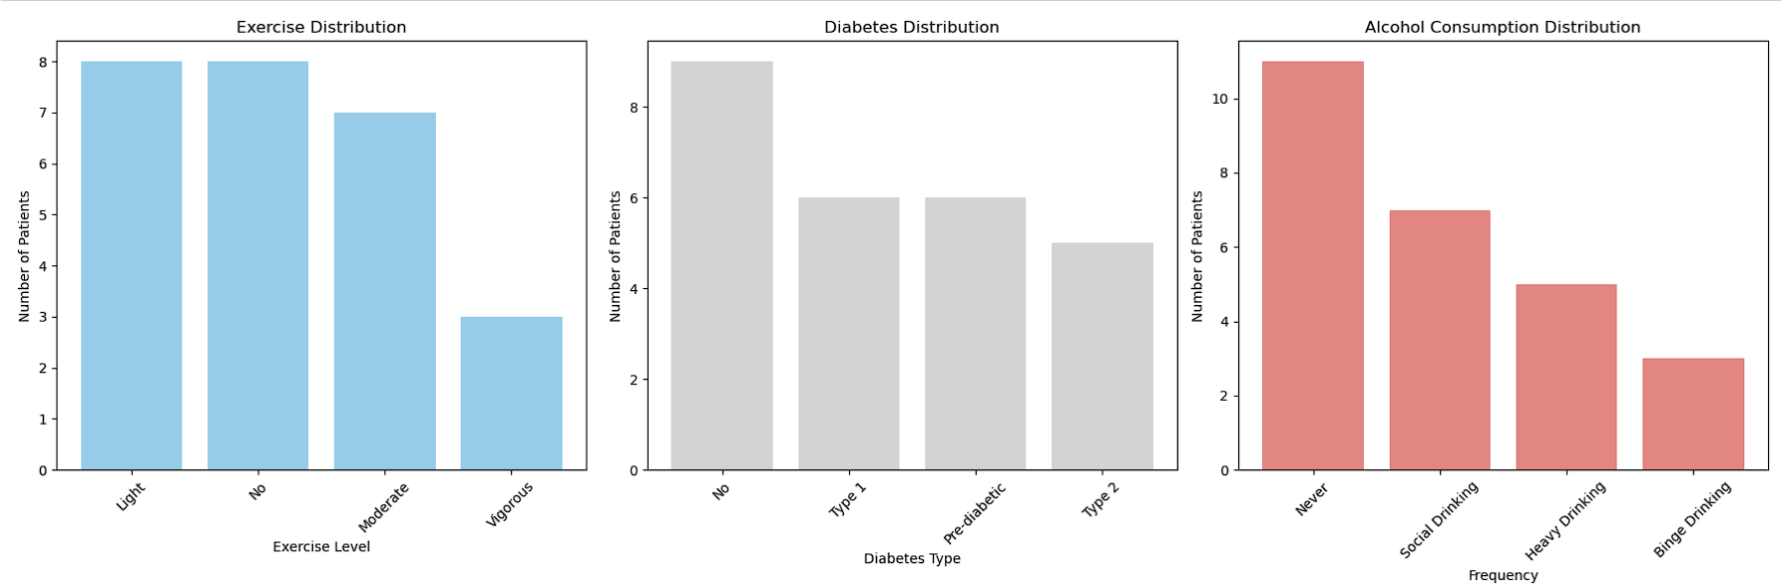
Patient Distribution
Using Matplot, a subplot was created to visualize different patient distributions among different groups. This code can be edited to show other distributions in the database.

Slide 20
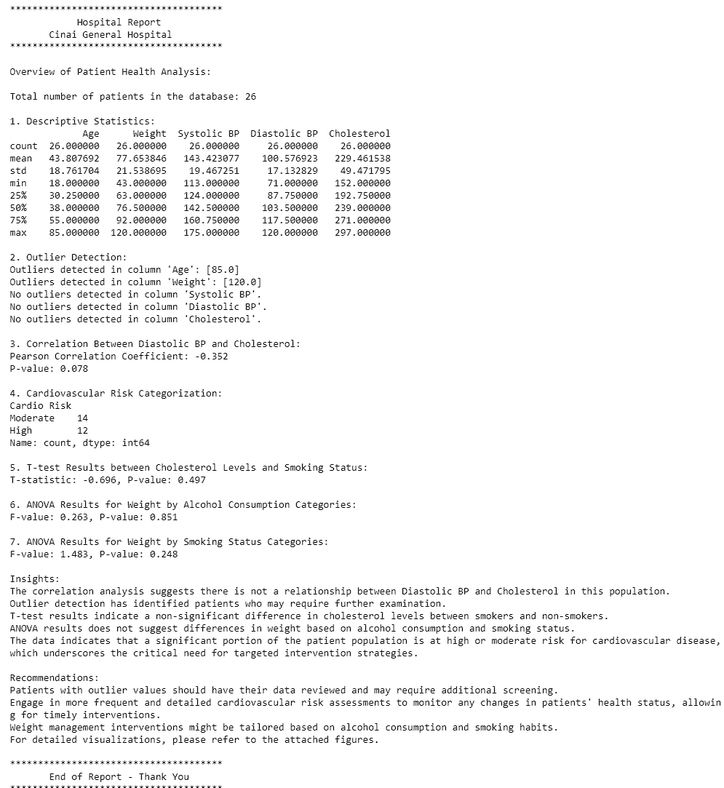
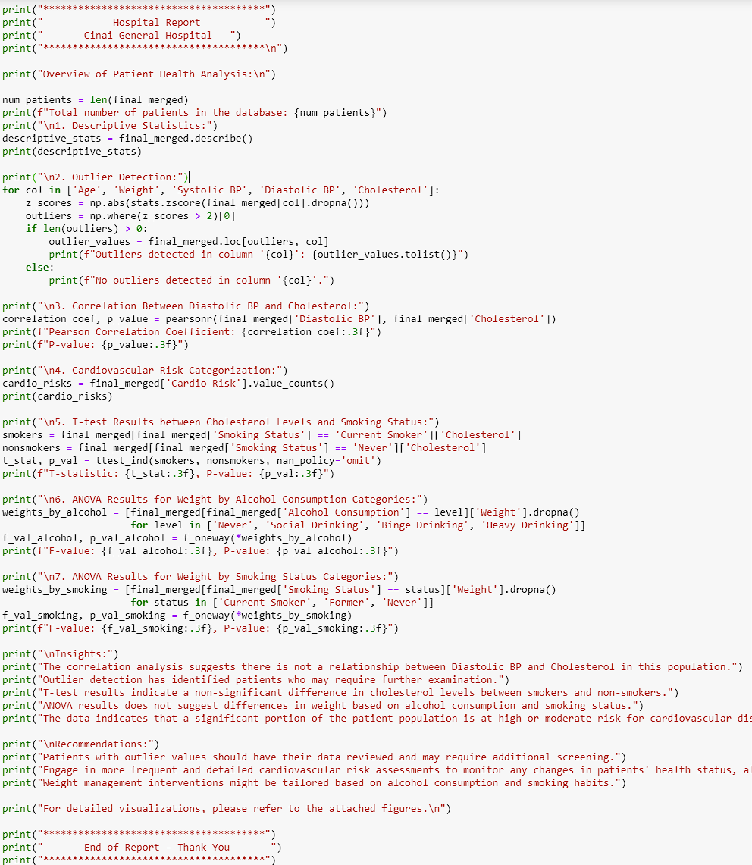
Overview Report

Slide 21
References
Cardiovascular diseases (CVDs). (2021, June 11). Retrieved from World Health Organization: https://www.who.int/news-room/fact-sheets/detail/cardiovascular-diseases-(cvds)#
Lifestyle Risk Factors. (2020, October 21). Retrieved from Centers for Disease Control and Prevention: https://www.cdc.gov/nceh/tracking/topics/LifestyleRiskFactors.htm#
Flint, A. C. (2019, July 17). Effect of Systolic and Diastolic Blood Pressure on Cardiovascular Outcomes. Retrieved from The New England Journal of Medicine: https://www.nejm.org/doi/full/10.1056/NEJMoa1803180#:
Zhang, Y. (2019, September 27). Associations of Blood Pressure and Cholesterol Levels During Young Adulthood With Later Cardiovascular Events. Retrieved from PMC PubMed Central: https://www.ncbi.nlm.nih.gov/pmc/articles/PMC6764095/

